Slide 1
Low-Carbon Electricity Generation: A Comprehensive Analysis
A.Y. 2022/2023
Valerio Rocca, Giacomo Virginio

Slide 2
Table of contents
01
02
03
Pre-processing and EDA
Descriptive Analyses
Data Modeling

Slide 3
01
Pre-processing and EDA

Slide 4
11
Number of datasets merged to obtain the final one

Slide 5
The datasets
Energy dataset
Other datasets
Dataset containing the main features (e.g., electricity generation from X source, net electricity import).
Contains a row for each country and for each year.
Datasets containing additional features useful for the analyses (e.g., death rate from air pollution, oil reserves).
Those datasets have been left joined to the Energy dataset.

Slide 6
Pre-processing
01
02
03
Unit Selection
Feature Selection
04
Feature Renaming
Cleaning NA Values

Slide 7
The final dataset
16, 338
47
Number of rows
Variables

Slide 8
Exploratory Analysis
Plotting
Variables Transformation
Distribution of all variables over all years
Distribution of variables in 2016
Percentage of NA values of each variable by year
Correlation plots
Application of division by millions of population and applying logarithm function.
Creation of subset with single year data for year 2016

Slide 9
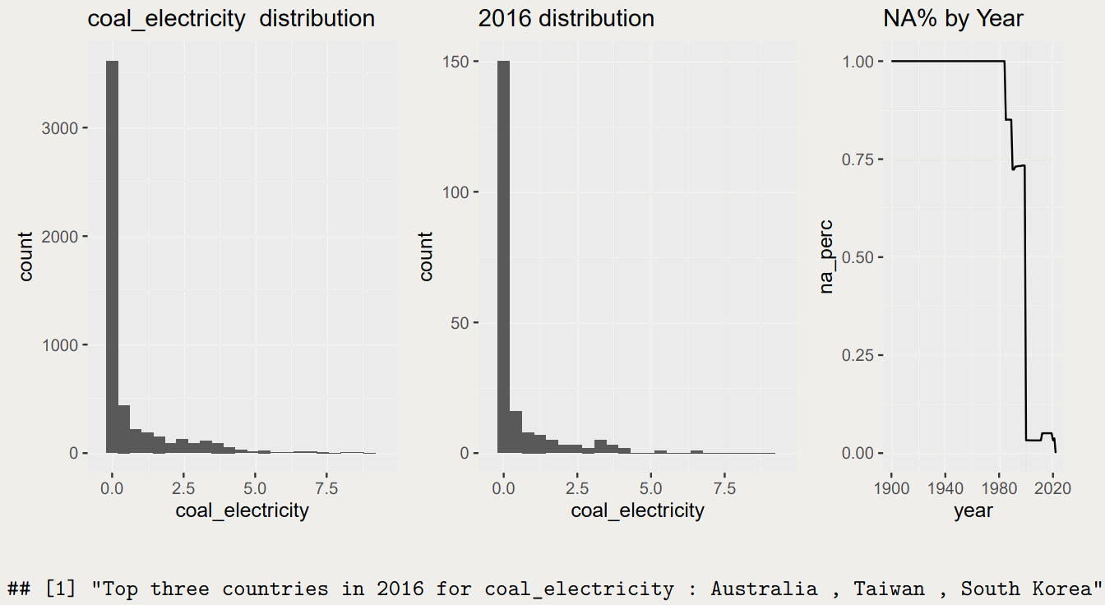

Slide 10
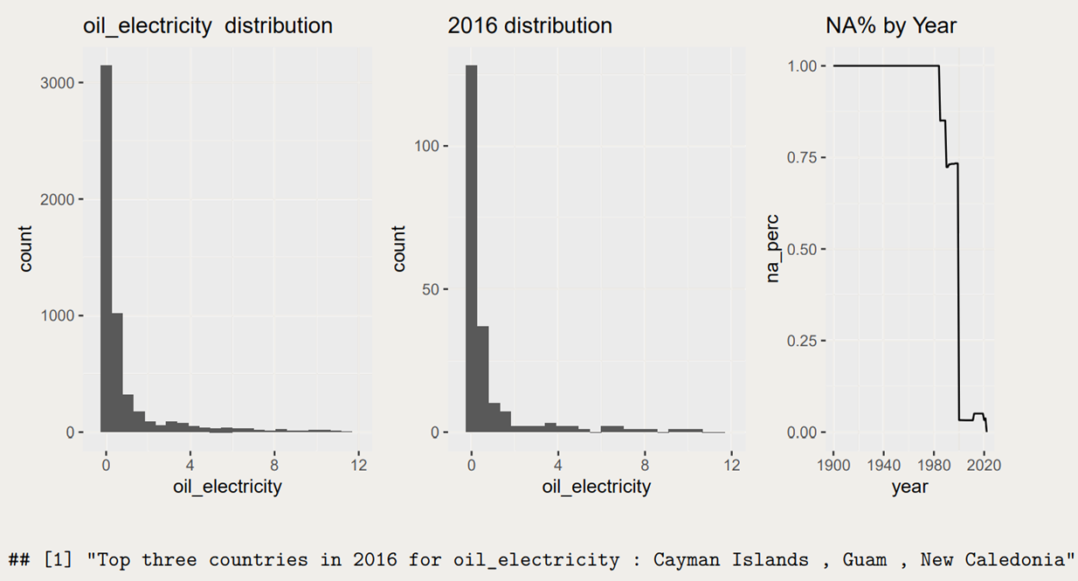

Slide 11
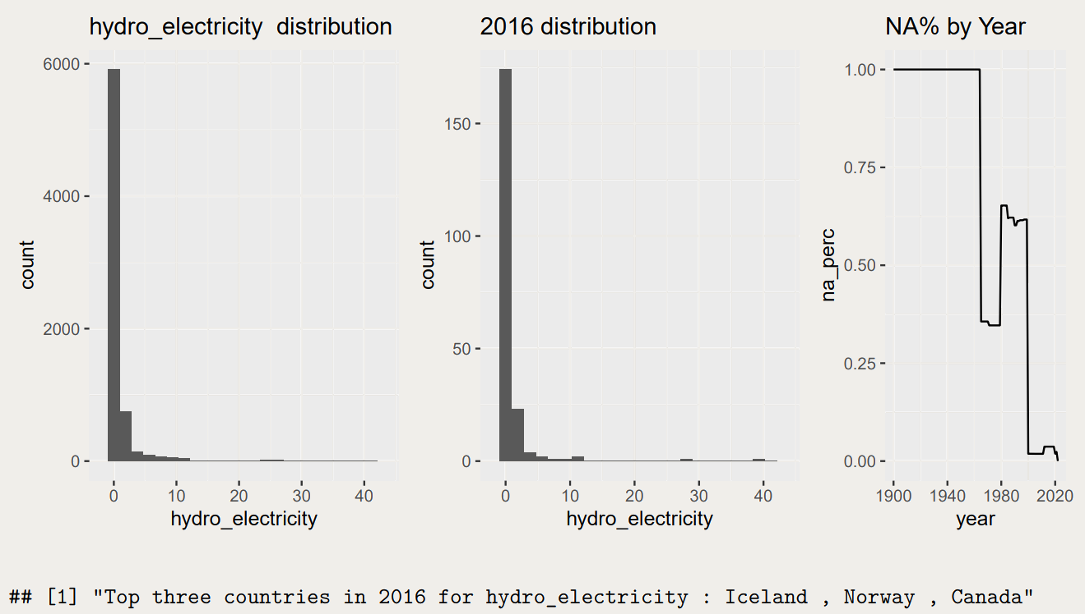

Slide 12
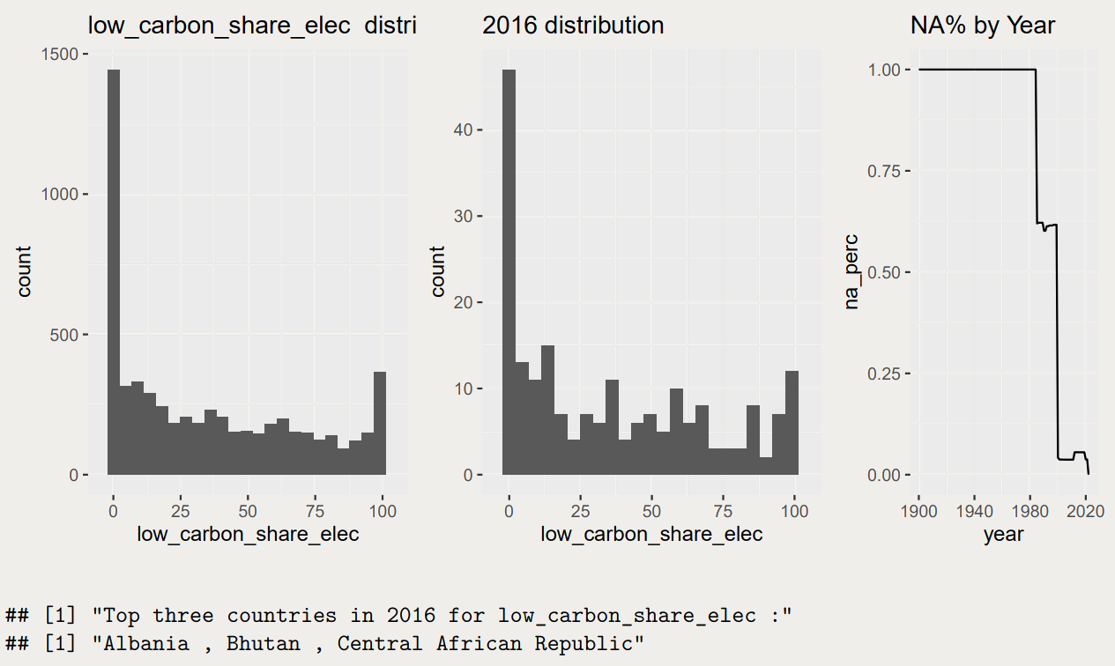

Slide 13
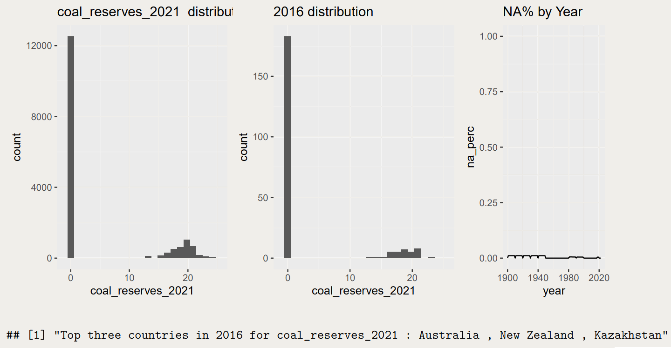

Slide 14
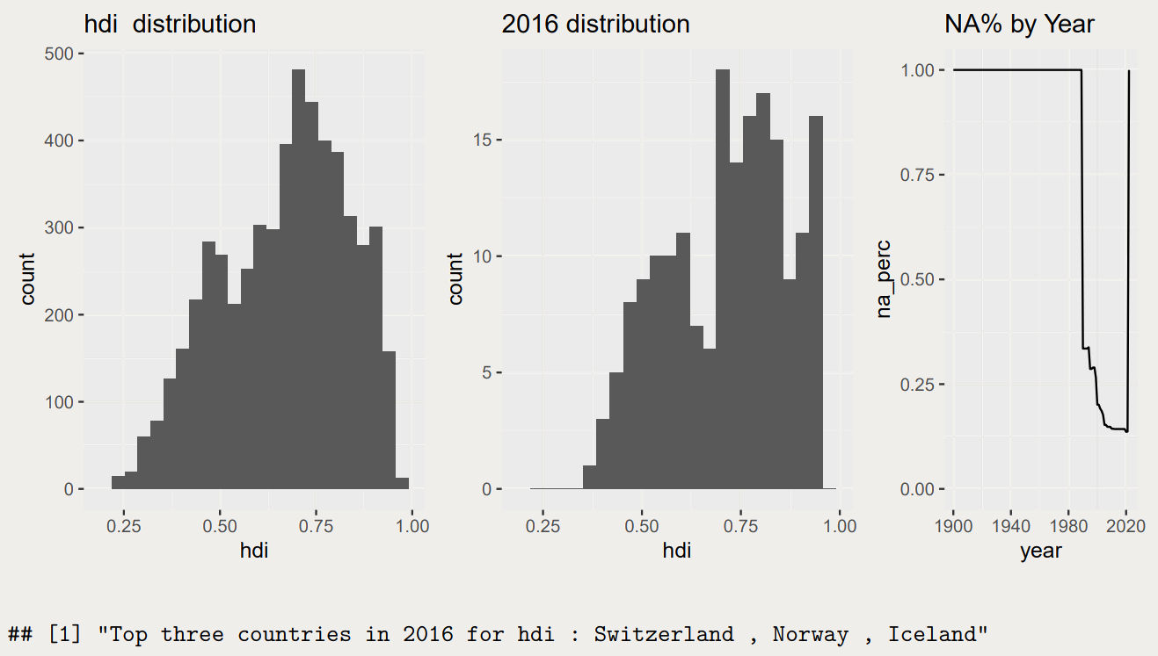

Slide 15
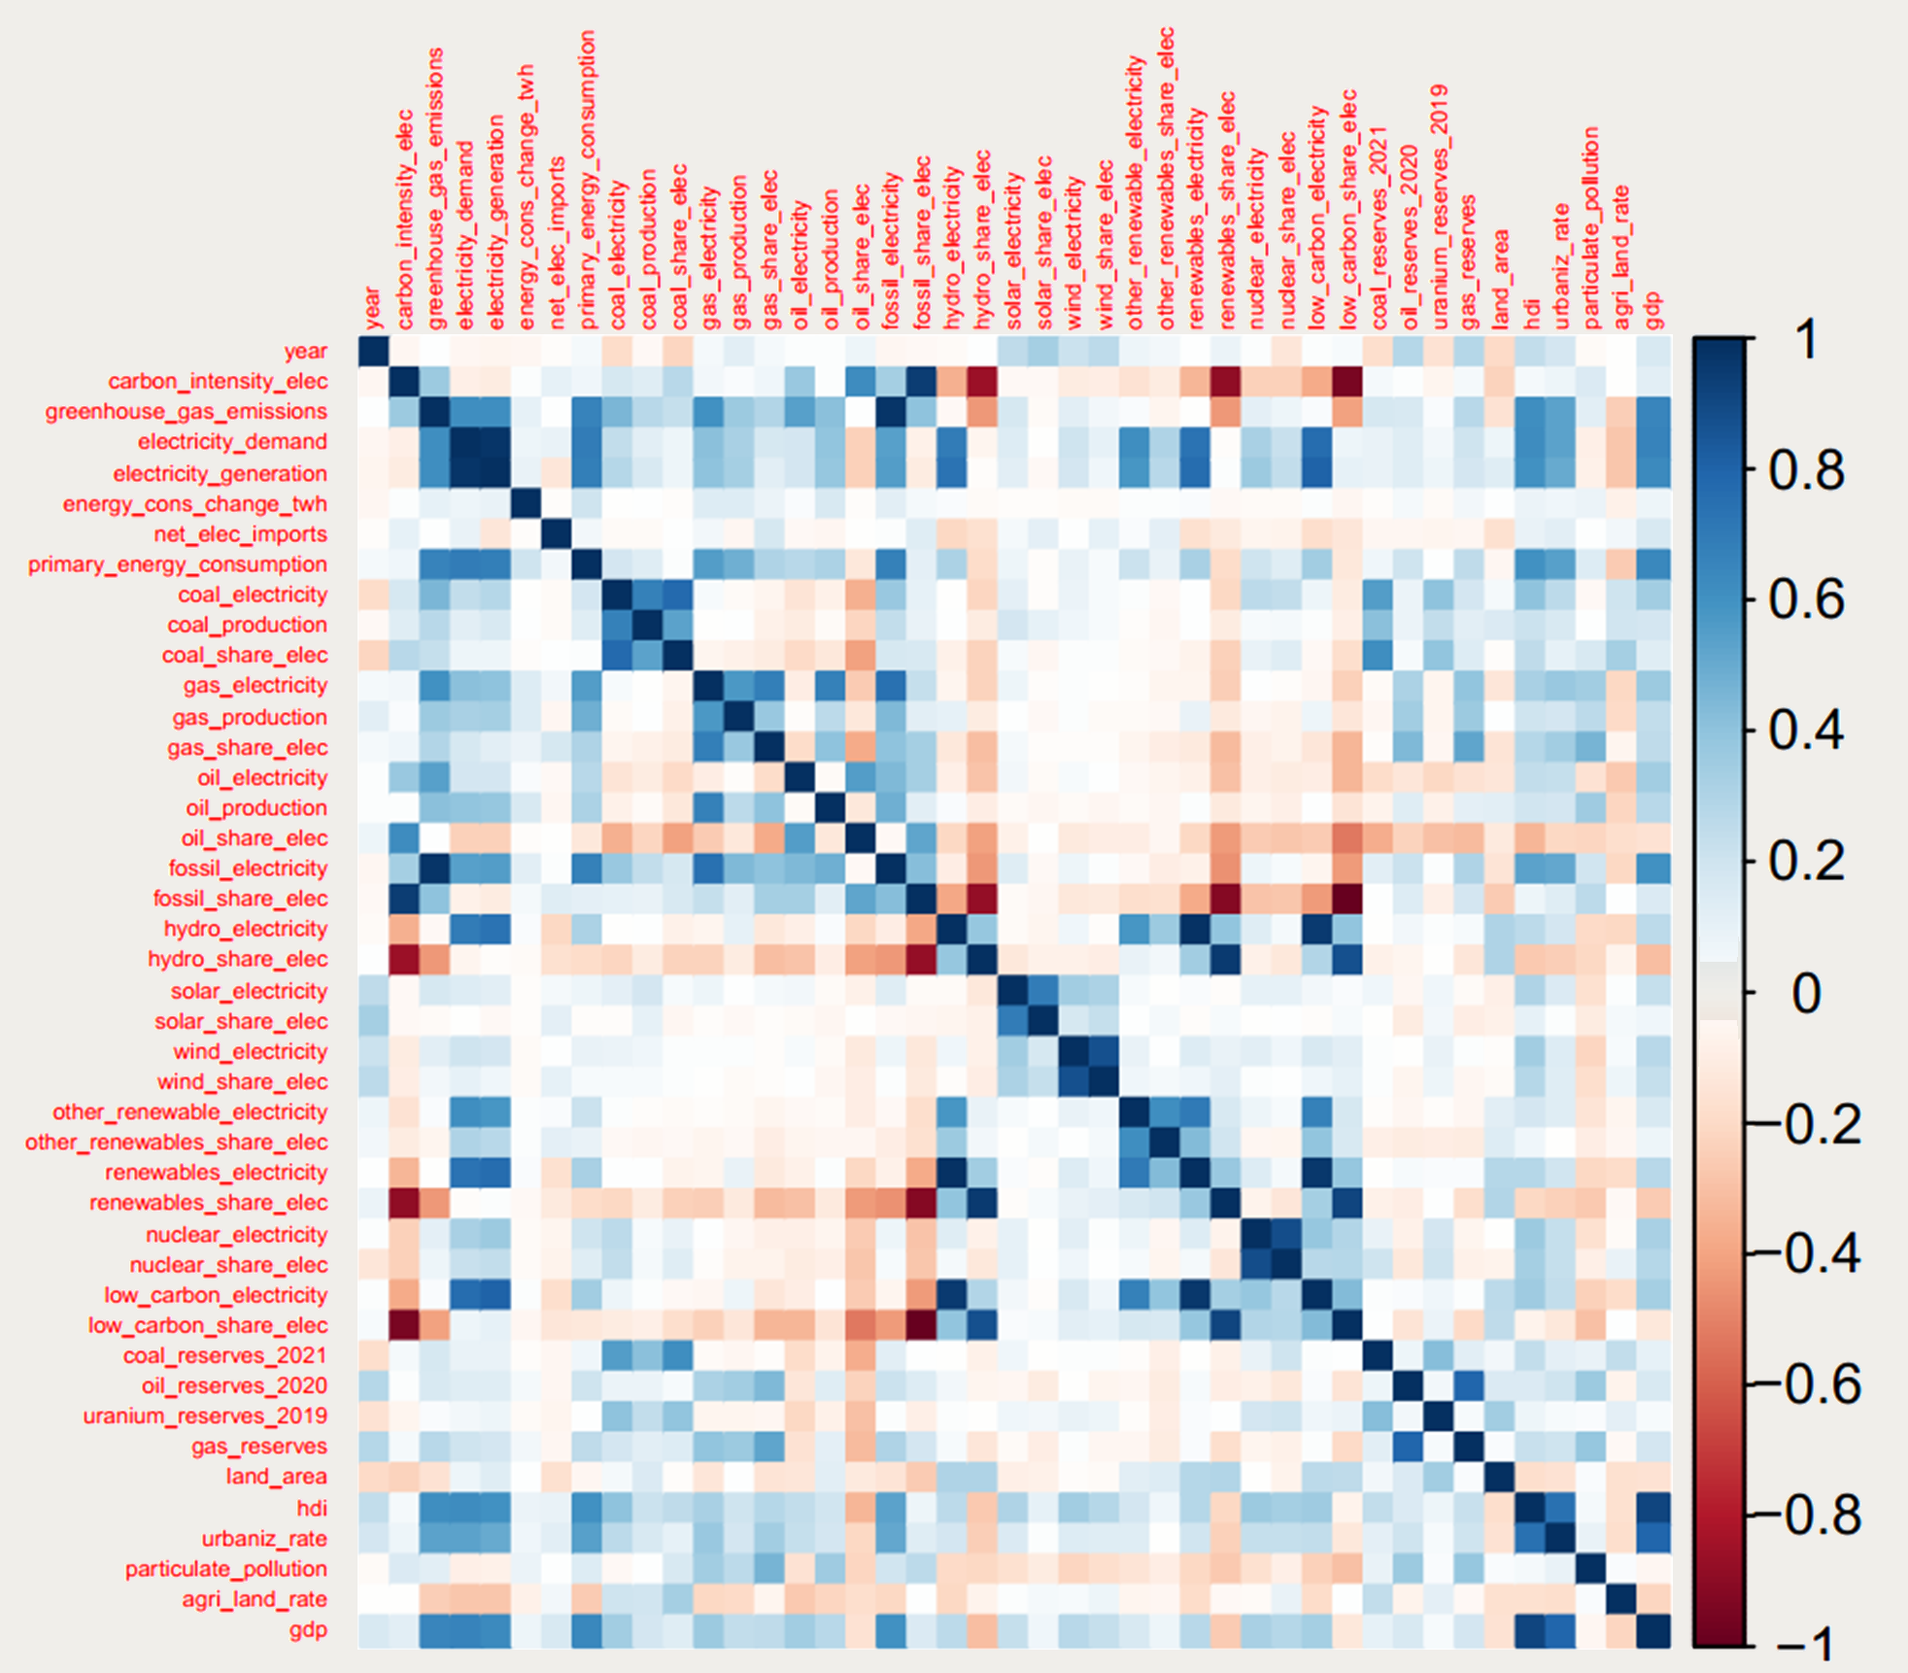
Correlation plot among all variables

Slide 16
02
Descriptive Analyses

Slide 17
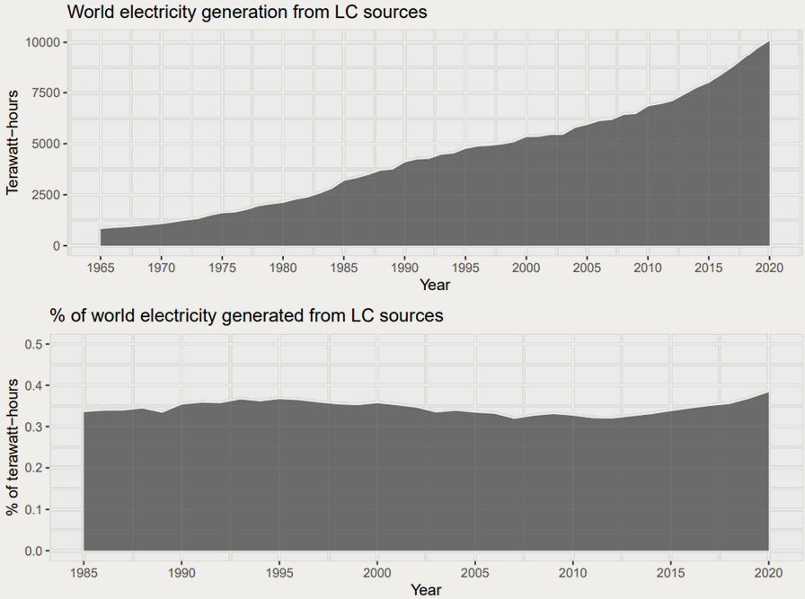
A global overview
Average yearly growth of electricity generation from LC source: 21.6%

Slide 18
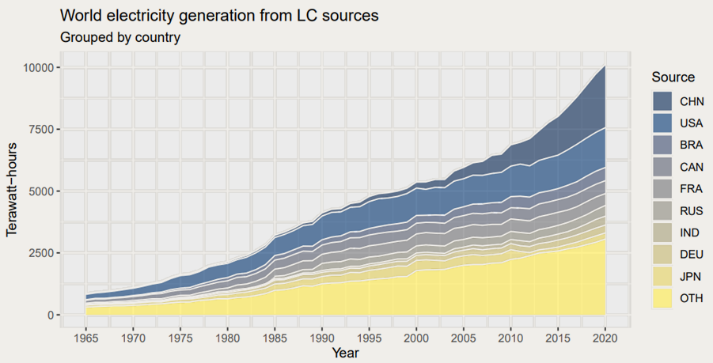
A global overview
Share of LC electricity generated by China and USA: 41%

Slide 19
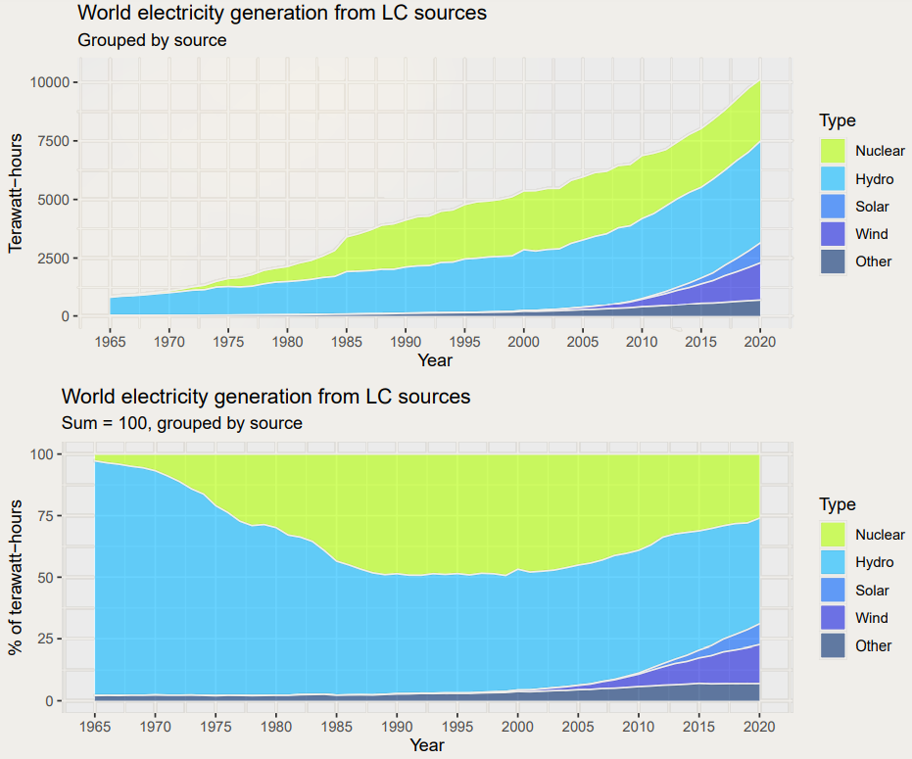
History of low-carbon generation

Slide 20
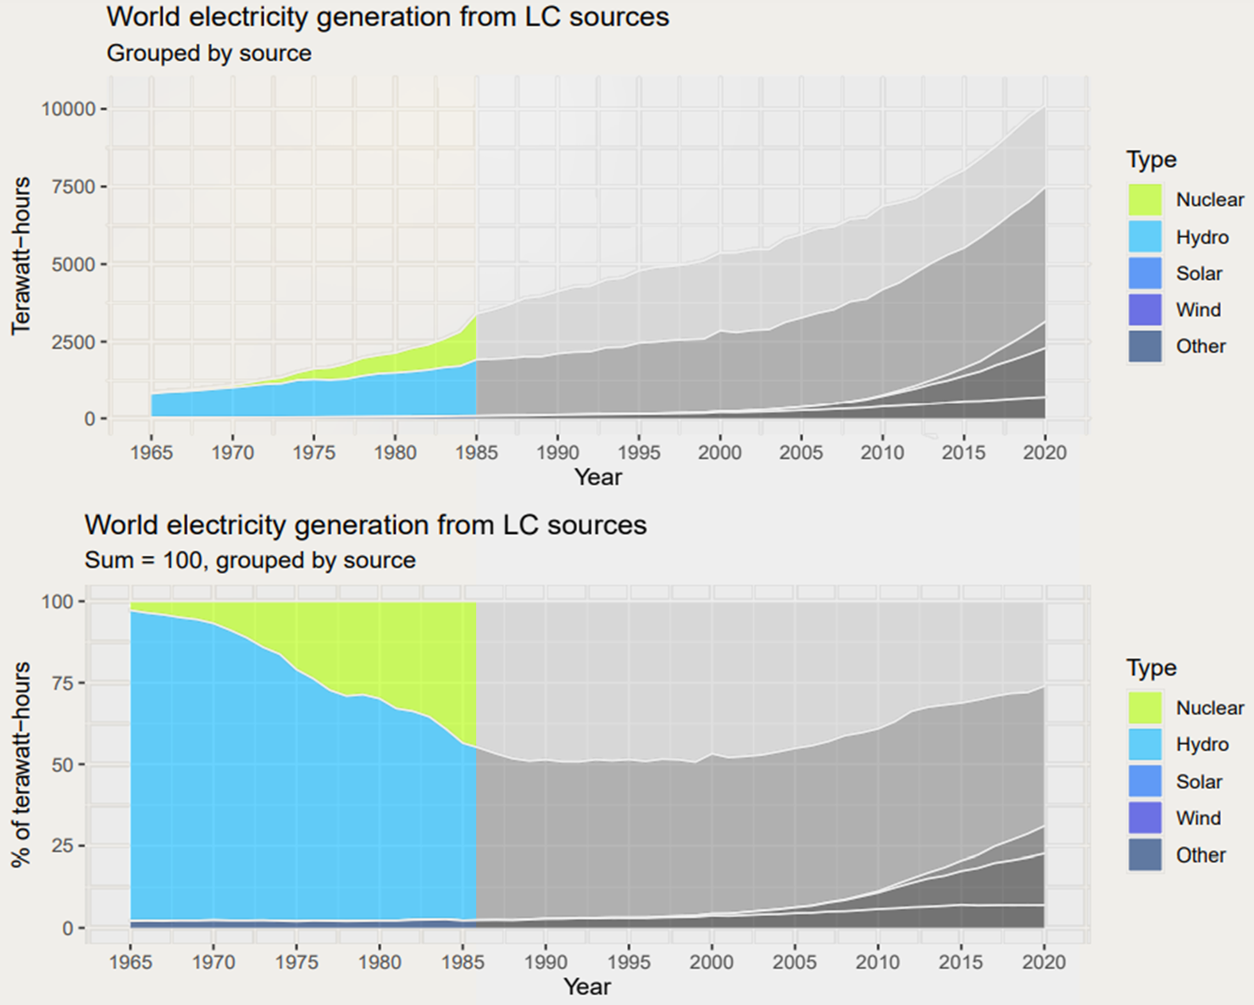
First phase: the dawn of nuclear

Slide 21
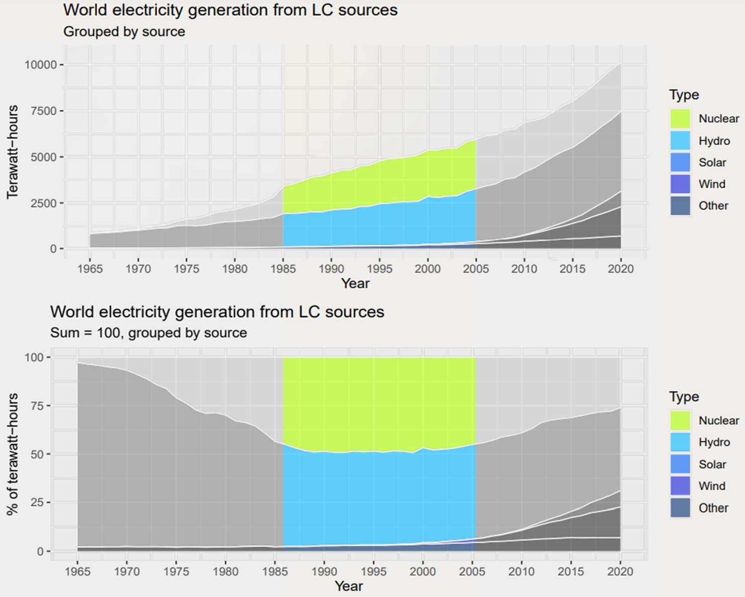
Second phase: nuclear’s golden age

Slide 22
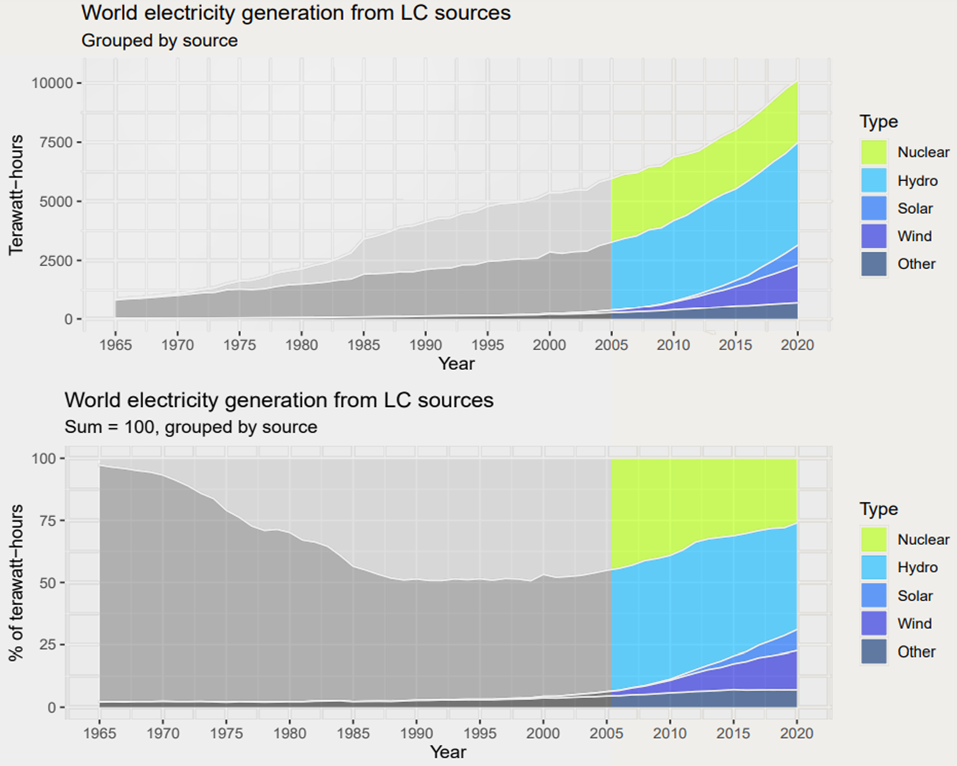
Third phase: renewables’ golden age

Slide 23
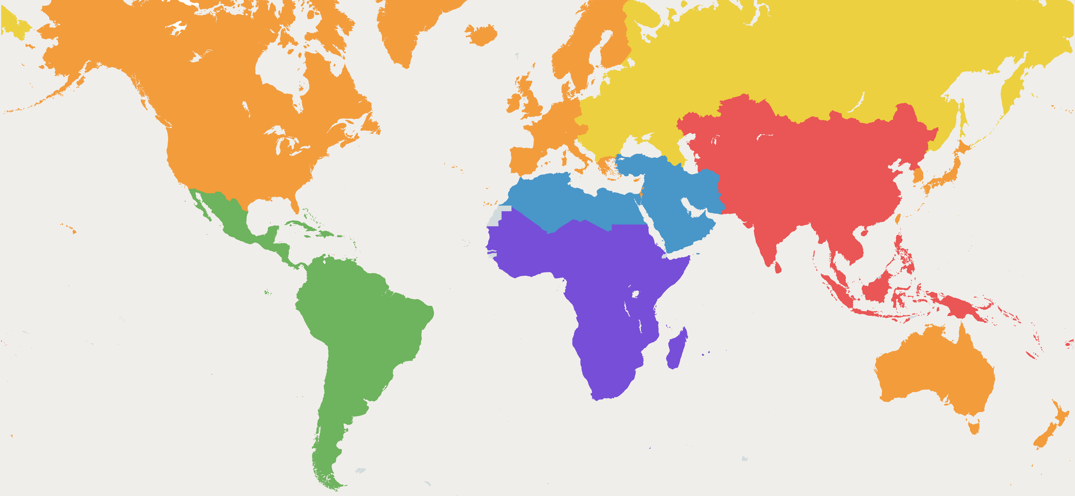
Grouping in macroregions

Slide 24
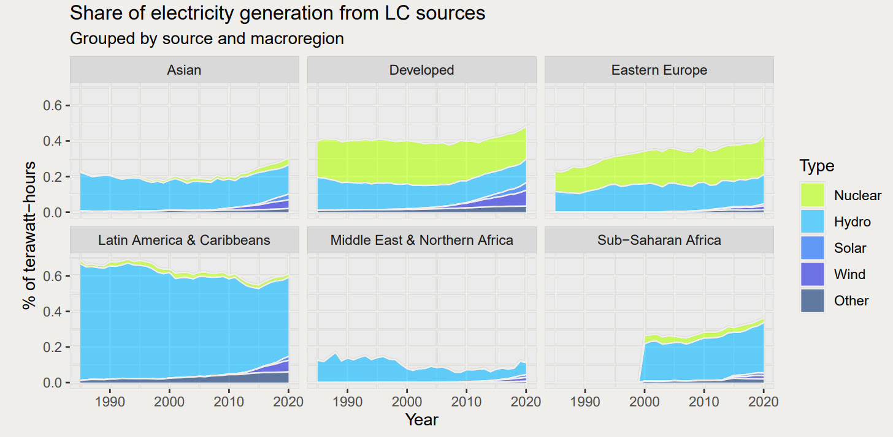
Low-carbon and macroregions: how does generation vary?

Slide 25
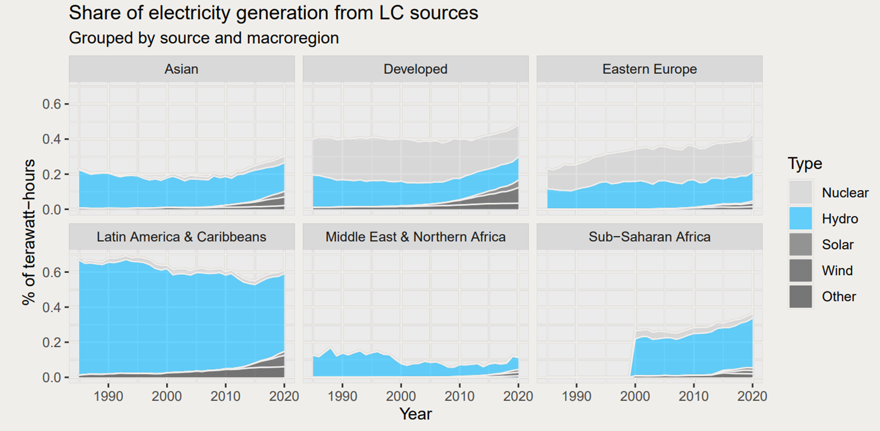
Transversal importance of hydropower

Slide 26
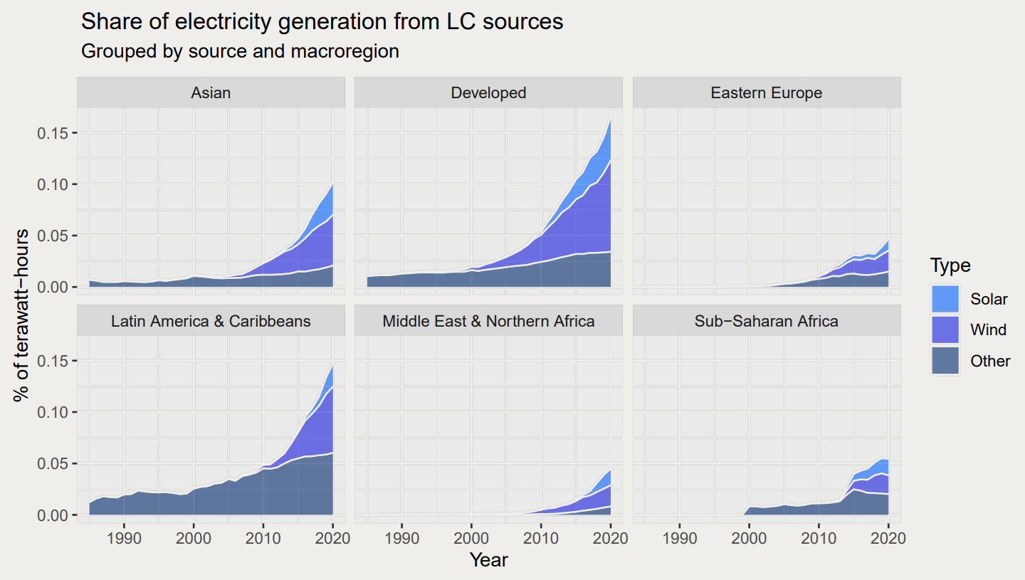
Zoom on non-hydro renewables

Slide 27
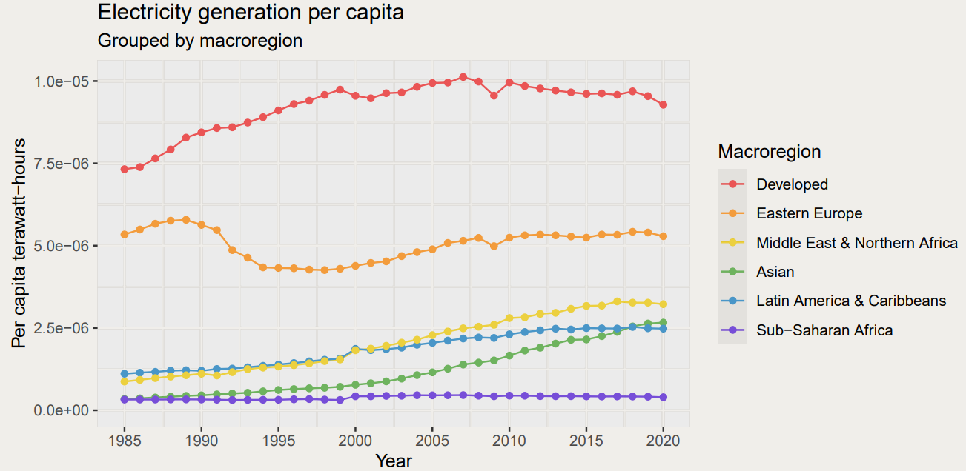
Higher share means stronger green transition?

Slide 28
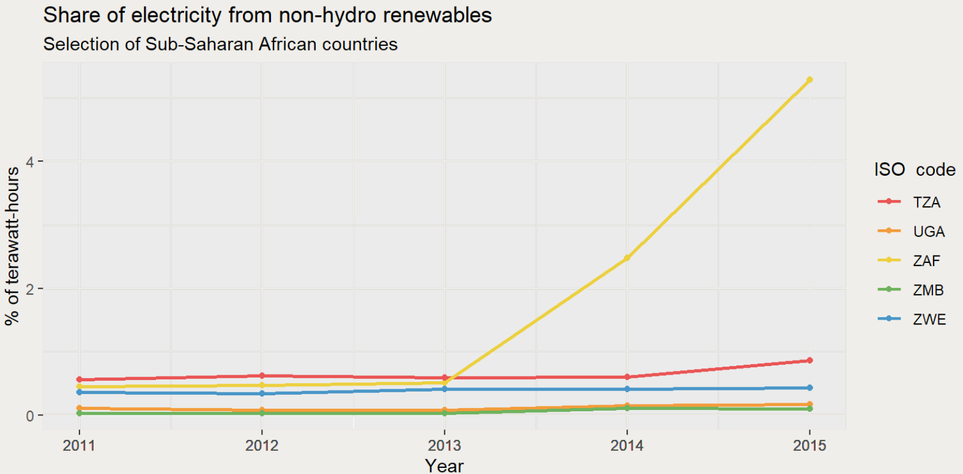
South-Africa: the outperforming country

Slide 29
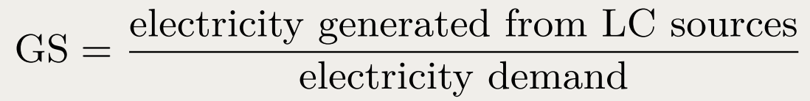
The Green Score

Slide 30
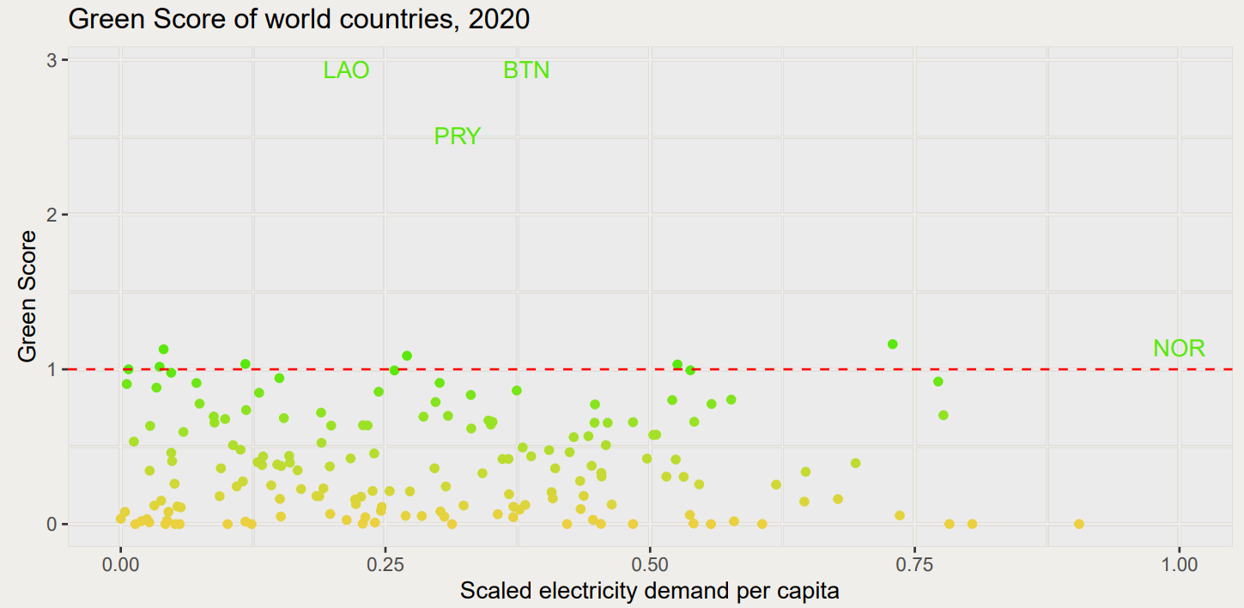
Green Score in different countries
Outliers highlighted: Laos, Bhutan, Paraguay and Norway

Slide 31
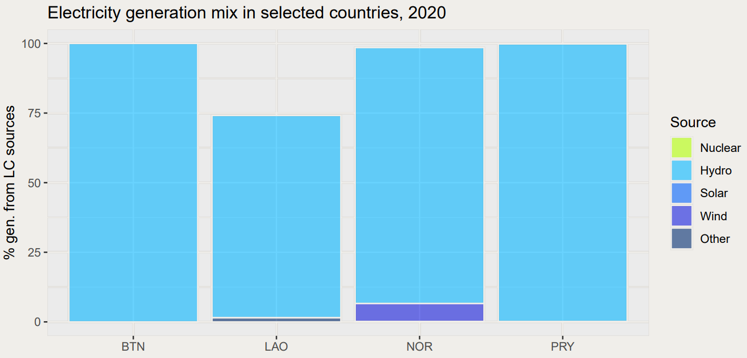
Hydropower dominance in the outliers

Slide 32
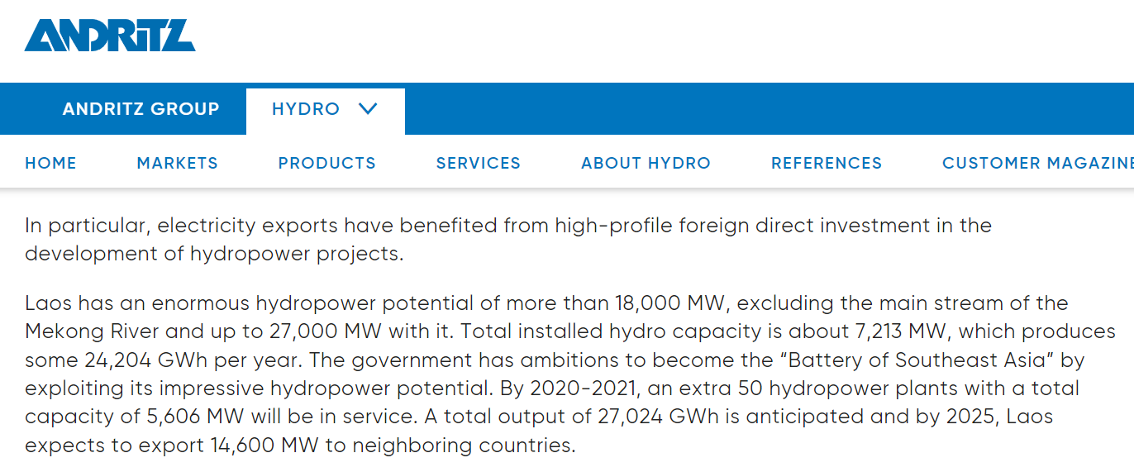
Laos: the Battery of Southeast Asia
https://www.andritz.com/hydro-en/hydronews/hydro-news-asia/laos

Slide 33
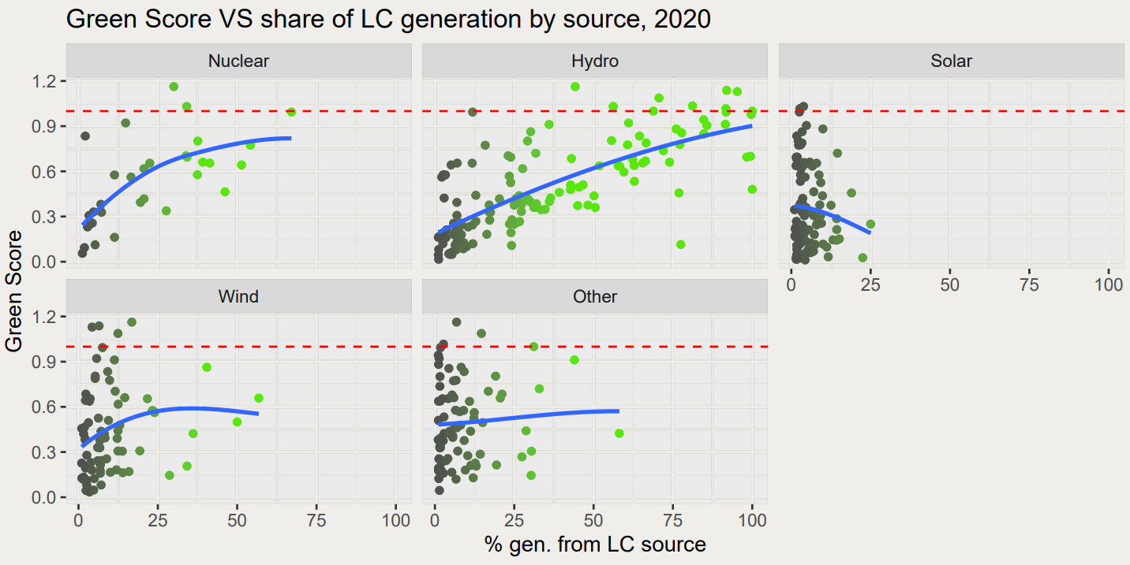
Which sources influence the Green Score?

Slide 34
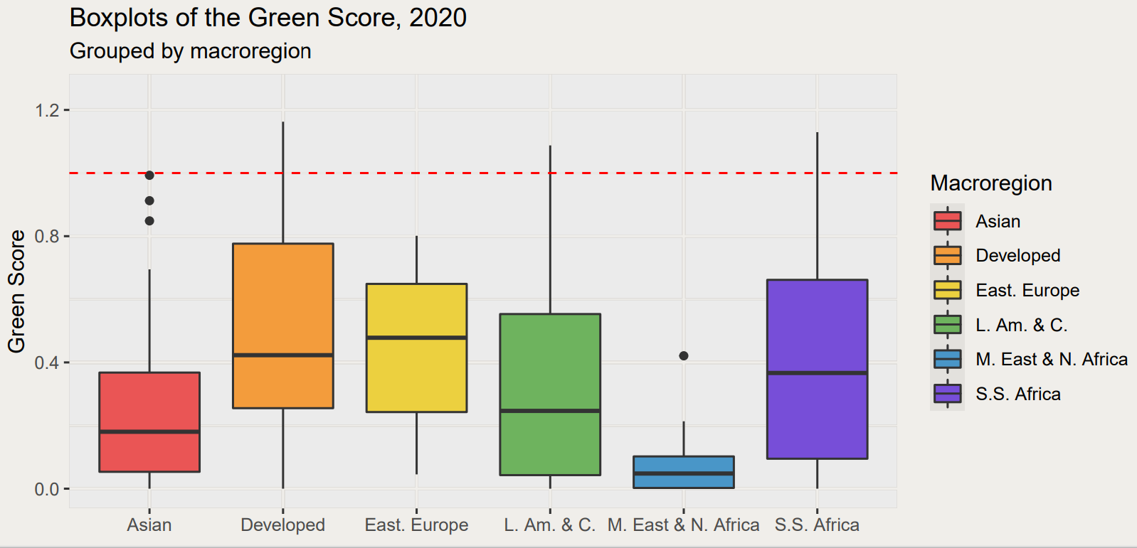
Macroregions and Green Scores

Slide 35
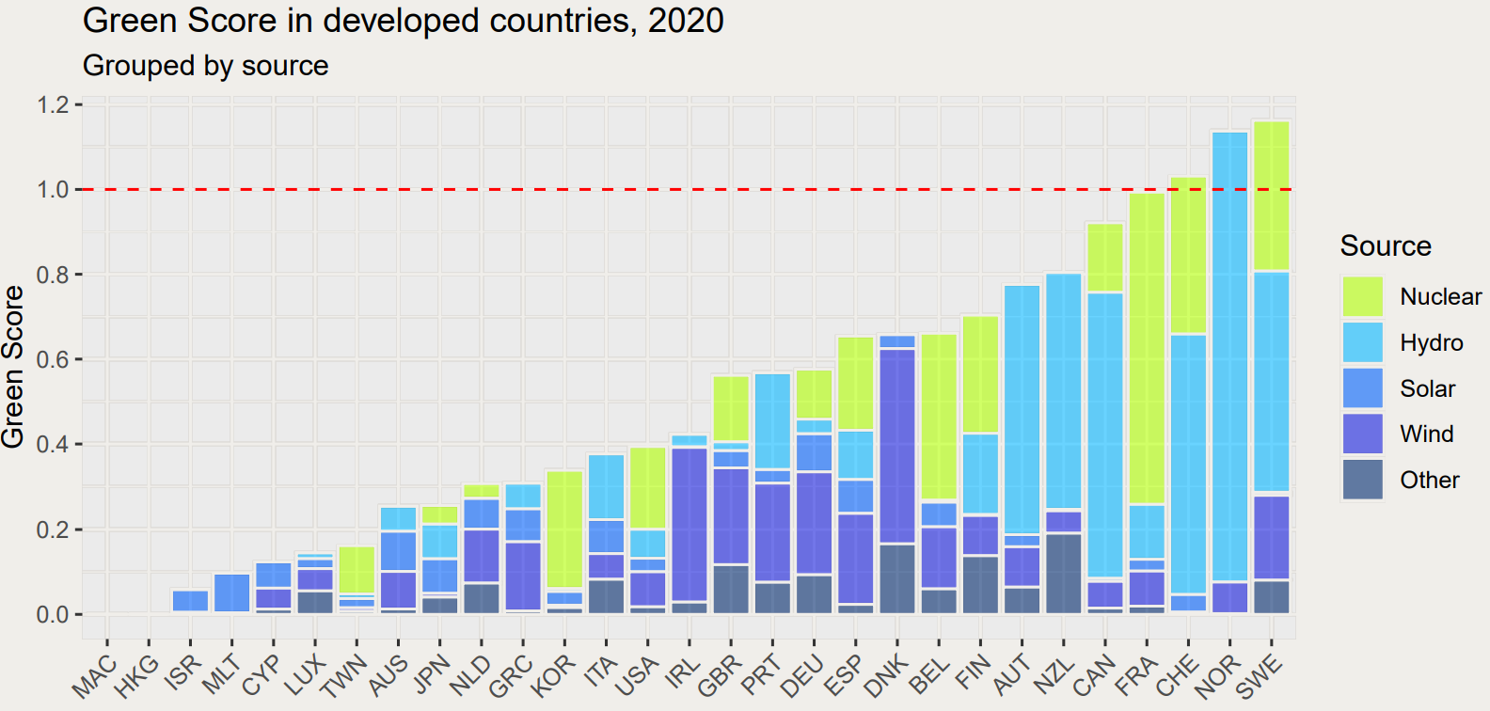
Developed Countries: an heterogeneous energy mix

Slide 36
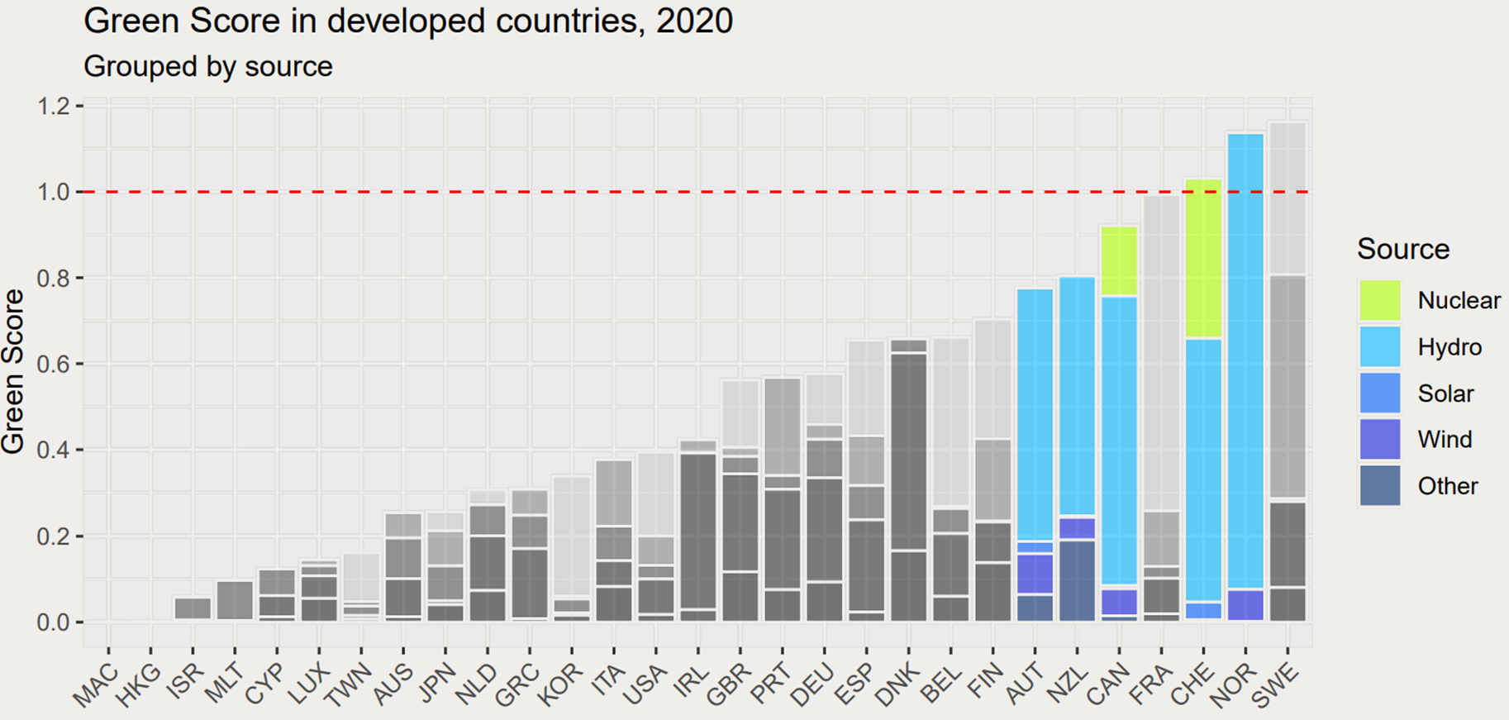
Developed Countries: some driven by hydropower

Slide 37
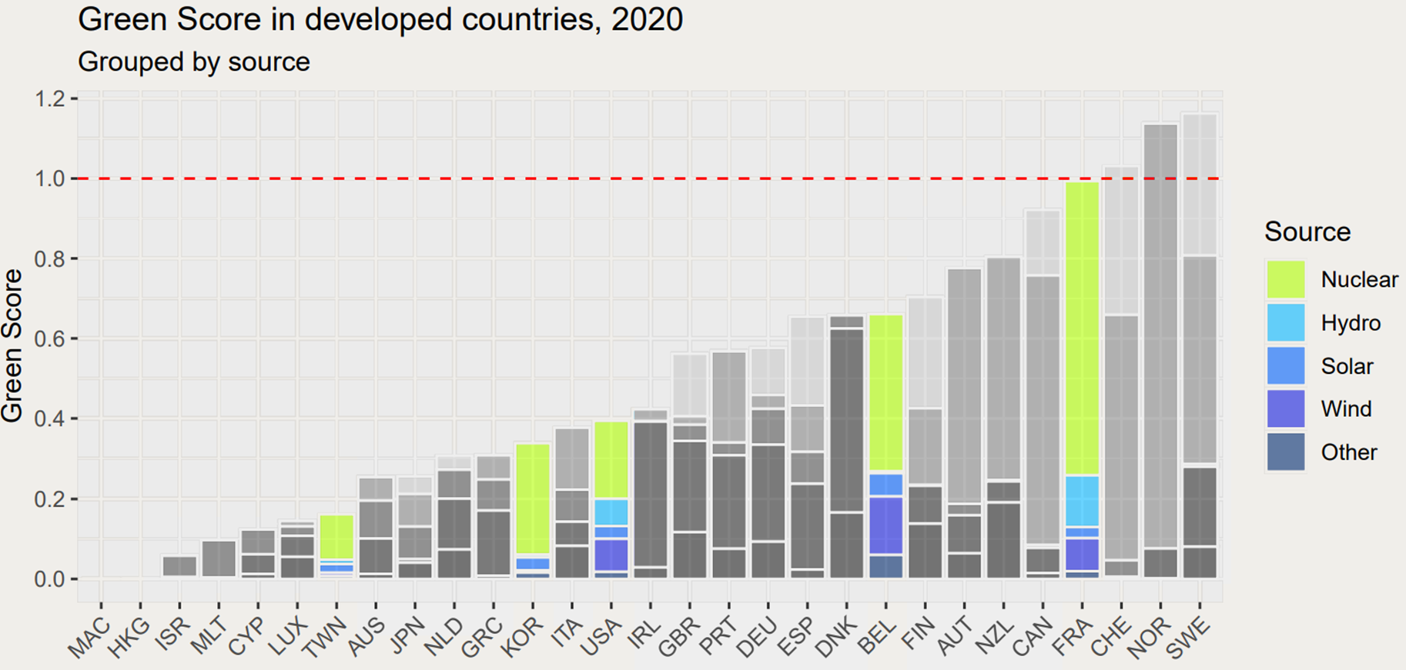
Developed Countries: others by nuclear power

Slide 38
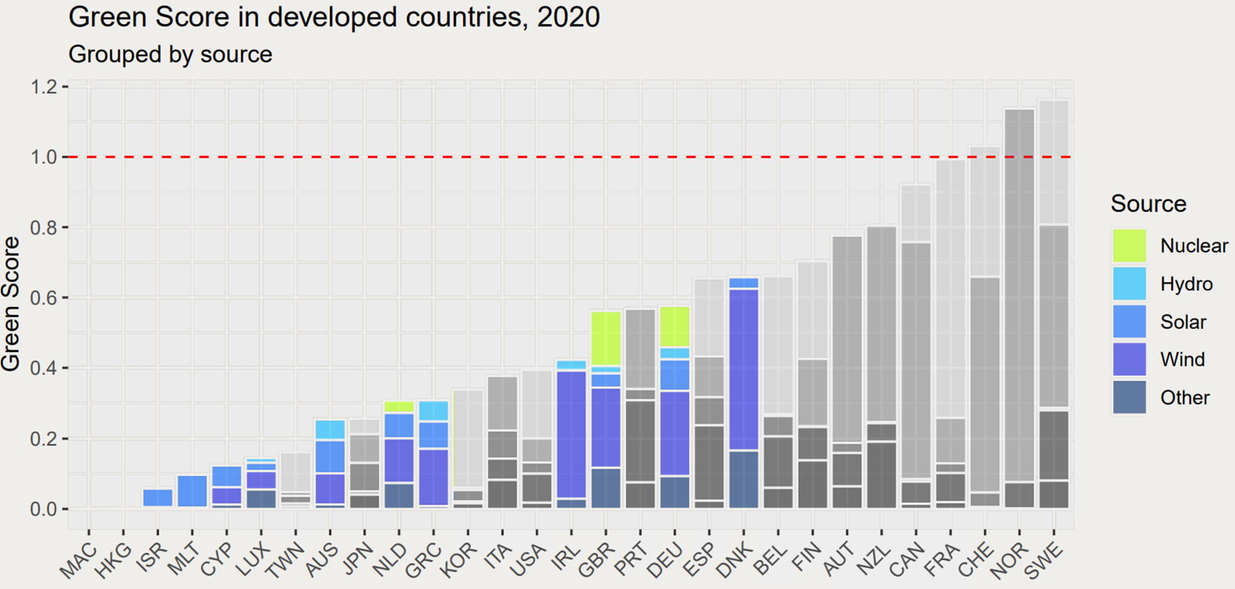
Developed Countries: others still by non-hydro renewables

Slide 39
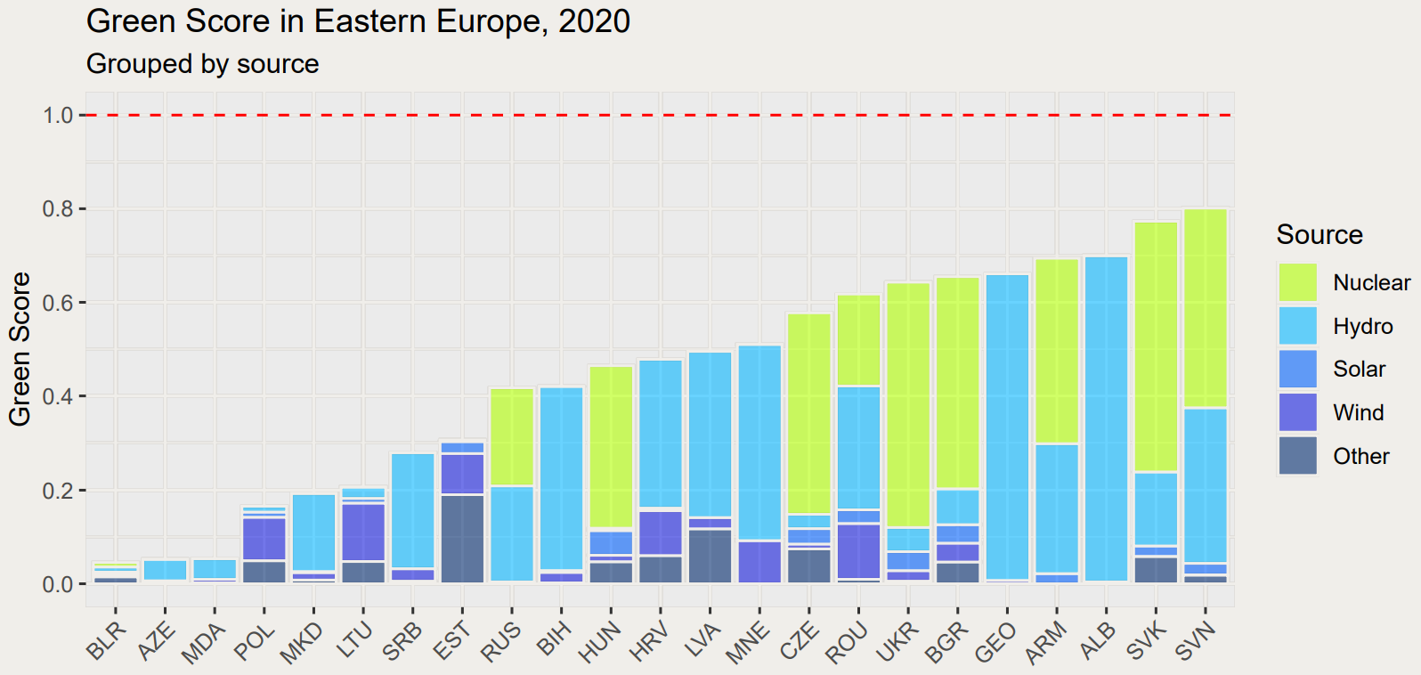
Eastern Europe: the nuclear region

Slide 40
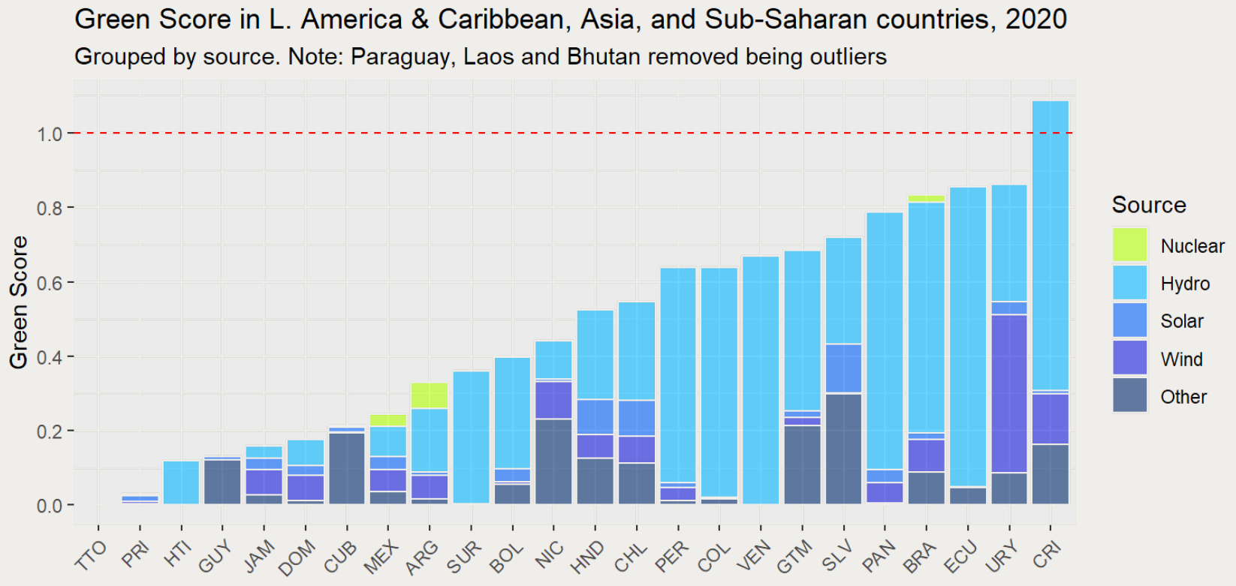
Latin-America, Asia and Sub-Saharan Africa: the hydropower rule

Slide 41
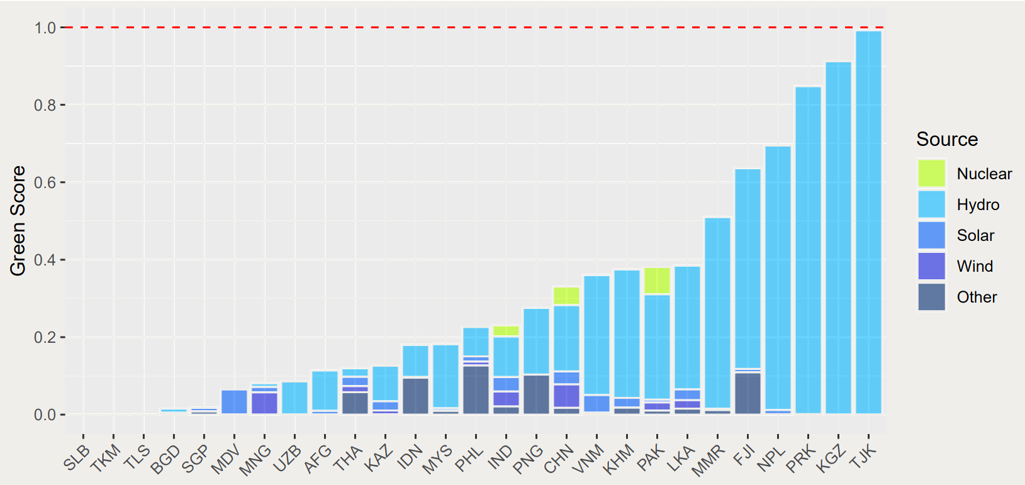
Latin-America, Asia and Sub-Saharan Africa: the hydropower rule

Slide 42
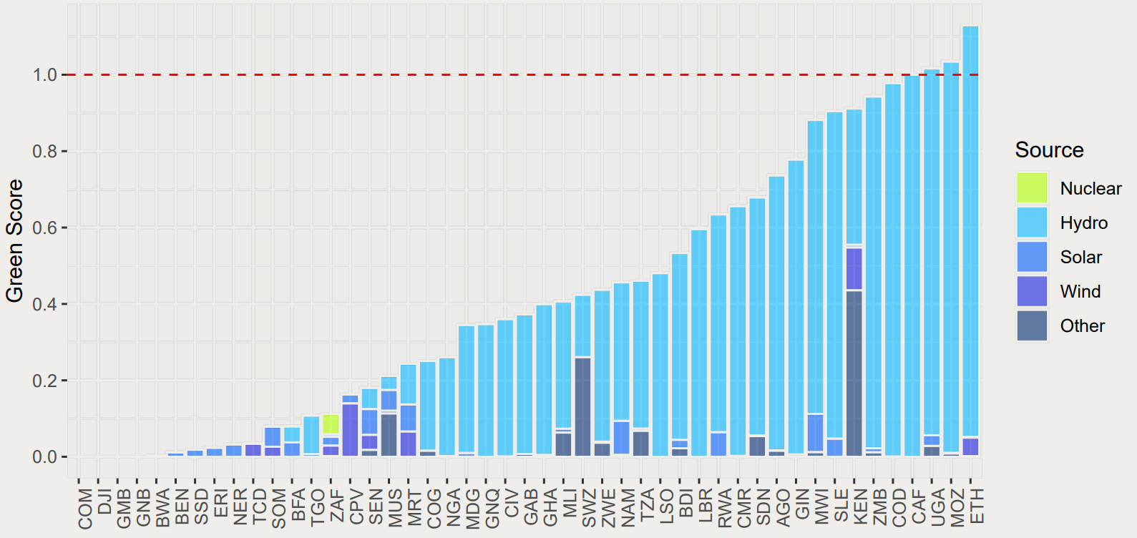
Latin-America, Asia and Sub-Saharan Africa: the hydropower rule

Slide 43
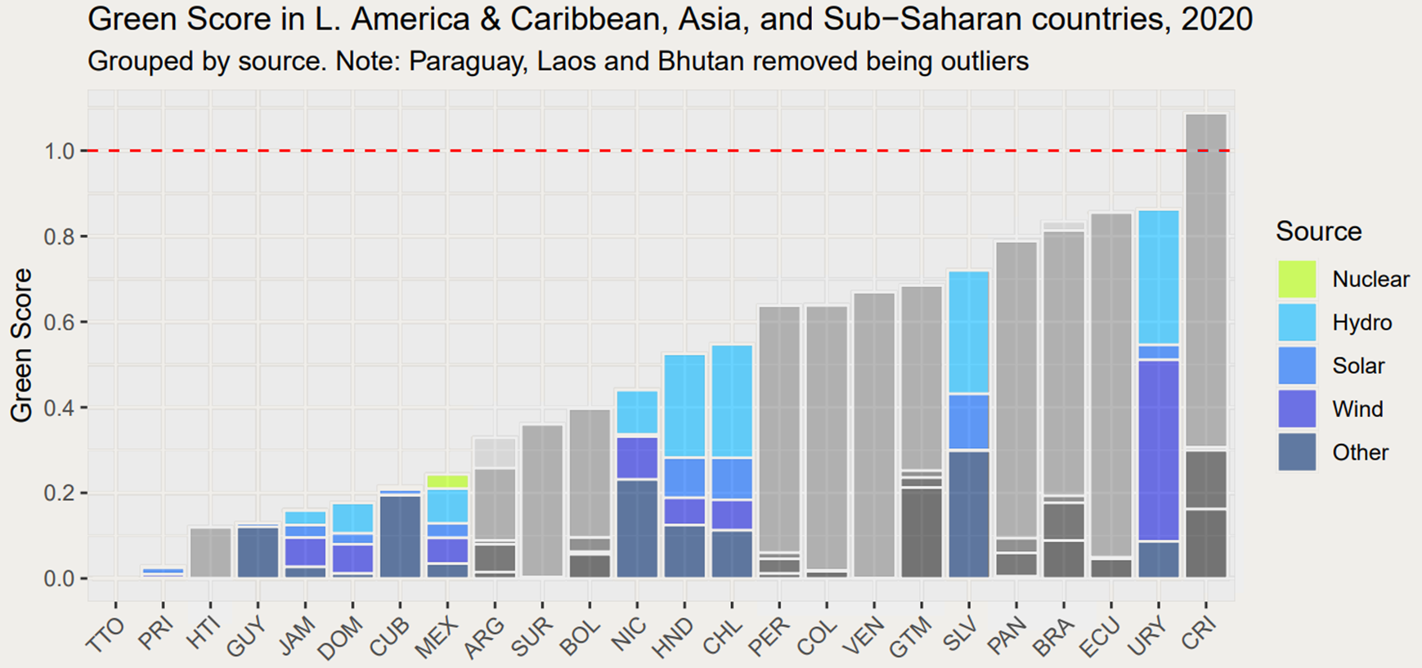
Uruguay: the wind republic

Slide 44
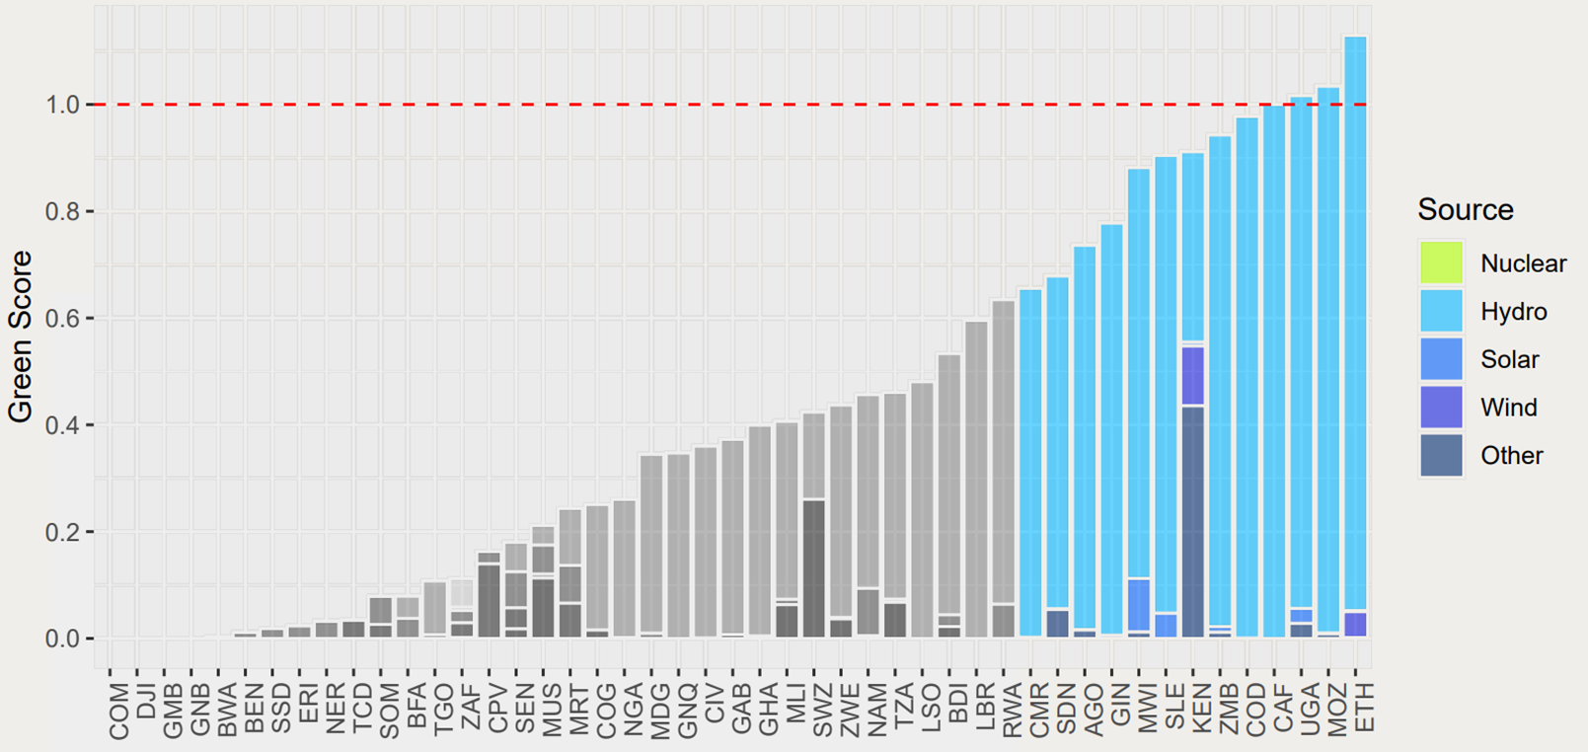
Kenya: a successful exploitation

Slide 45
Kenya: a successful exploitation
https://www.imf.org/en/Publications/fandd/issues/2022/12/country-case-kenya-taps-the-earth-heat

Slide 46
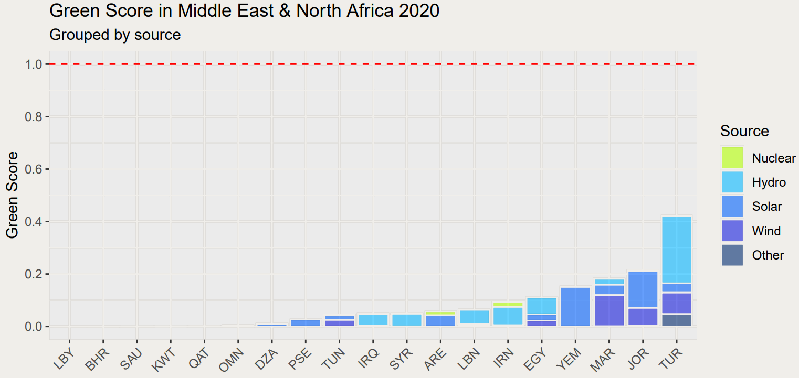
The Middle East and North Africa: the fossil fuel dependency

Slide 47
Per capita reserves of oil and gas
 | Oil (2020) | Gas (2020)
Middle East & North Africa | 469.81 tonnes | 583,180.3 m³
Other countries | 18.40 tonnes | 22,920.9 m³

Slide 48
03
Data Modeling

Slide 49
Modeling Steps
Preparation
Function Definition
Models
Adding to dataset the tag variable (and dummy tag).
Subset for years between 2000 and 2019.
Keep only complete cases
normalization
logit
selectvar_nl
setup_lr
rs_models
do_models
Calling functions and analyzing best models obtained

Slide 50
Functions
selectvar_nl
normalize
- Dataset
- BYearwise
- Blogify
- BIndsource
- BTag
logify
do_models
rs_models
- Dependent
- Dataset
- Dependent
- Independent
- BTag
setup_lr
- Dataset
- Dependent
- Independent
- BTag

Slide 51
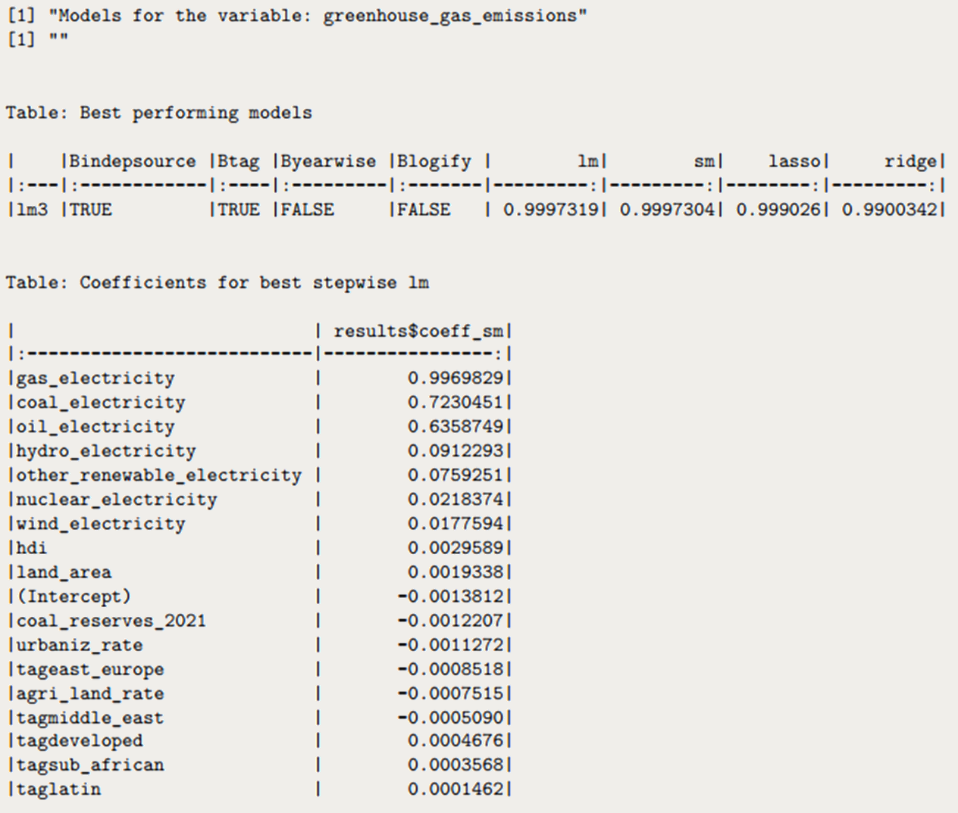
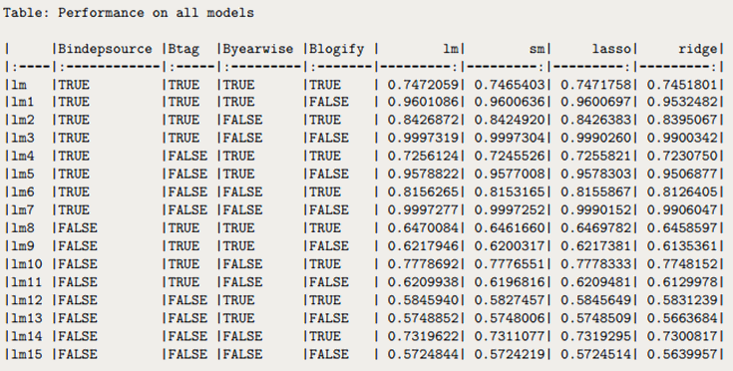
Models output

Slide 52
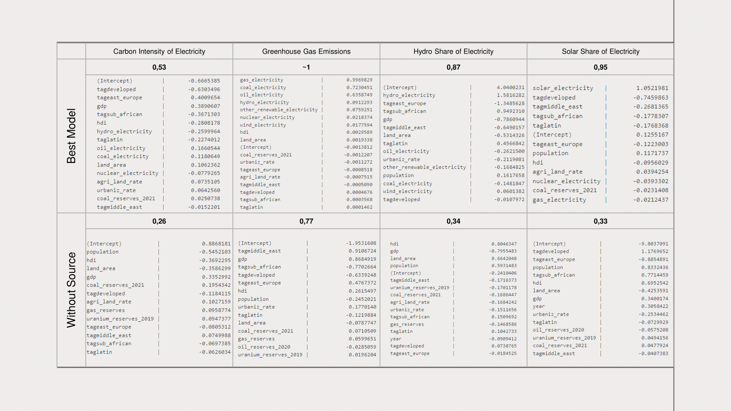
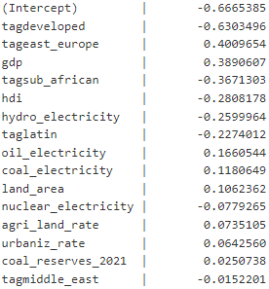
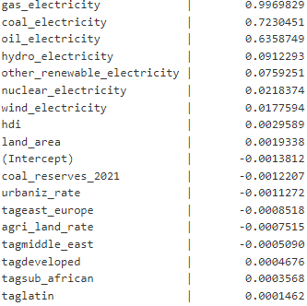
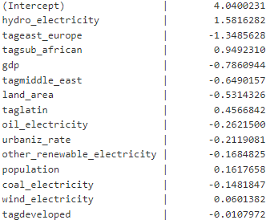
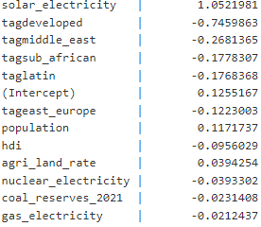
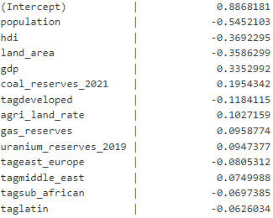
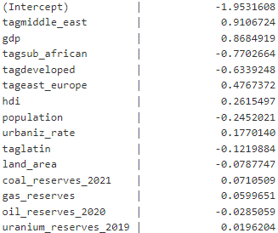
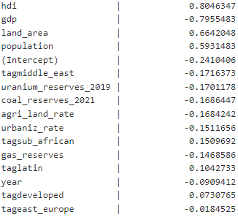
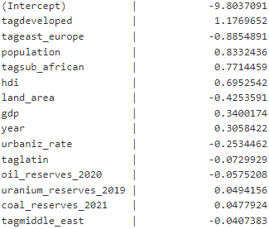
 | Carbon Intensity of Electricity | Greenhouse Gas Emissions | Hydro Share of Electricity | Solar Share of Electricity
Best Model | 0,53 | ~1 | 0,87 | 0,95
Best Model Coefficients
Without Source | 0,26 | 0,77 | 0,34 | 0,33
Best Model Without Source Coefficients

Slide 53
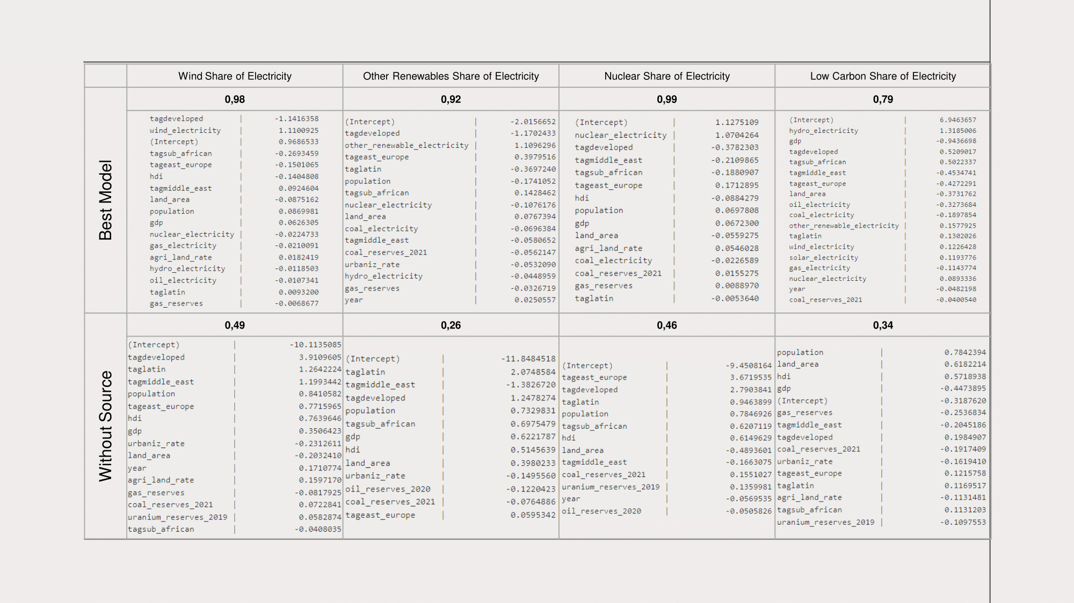
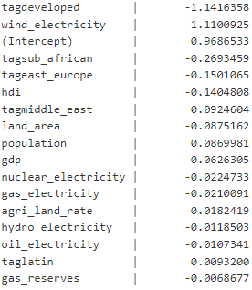
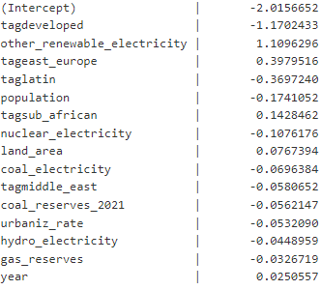






 | Wind Share of Electricity | Other Renewables Share of Electricity | Nuclear Share of Electricity | Low Carbon Share of Electricity
Best Model | 0,98 | 0,92 | 0,99 | 0,79
Best Model Coefficients
Without Source | 0,49 | 0,26 | 0,46 | 0,34
Best Model Without Source Coefficients

